Slide 1



Basics of Algorithmization and Program
Prepared & Presented by: Mirlan Nurbekov, Lecturer
Office hours: Friday 8:00–17:00
AlaToo IT & Business College
Fall 2025

Slide 2
Merge sort
Merge Sort is a divide-and-conquer sorting algorithm.
It works by dividing the array into smaller parts, sorting them, and then merging them back together.

Slide 3

Merge sort

Slide 4
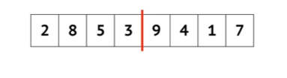
Merge sort

Slide 5
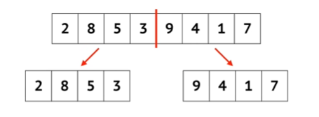
Merge sort

Slide 6
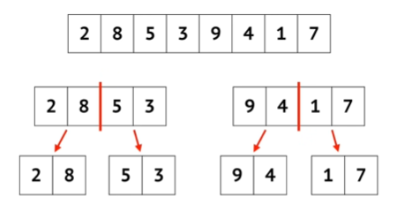
Merge sort

Slide 7
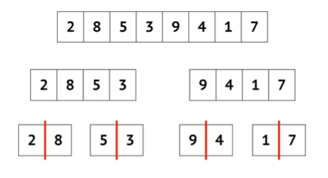
Merge sort

Slide 8
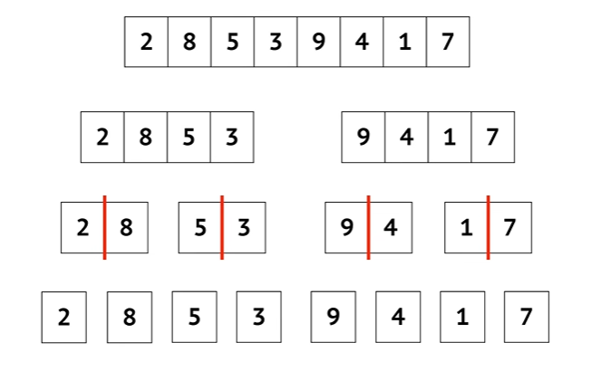
Merge sort

Slide 9
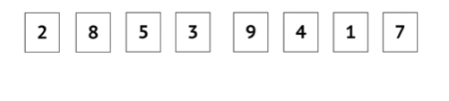
Merge sort

Slide 10
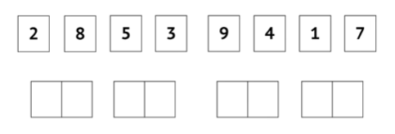
Merge sort
Merging into TEMPORARY arrays

Slide 11
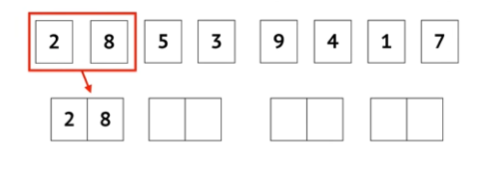
Merge sort

Slide 12
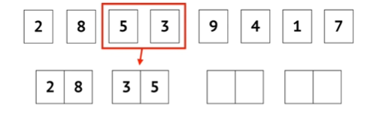
Merge sort

Slide 13
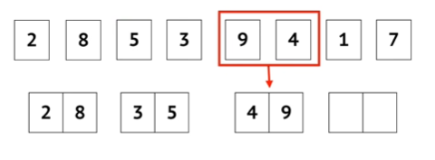
Merge sort

Slide 14
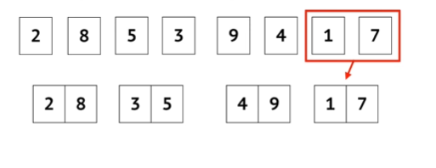
Merge sort

Slide 15
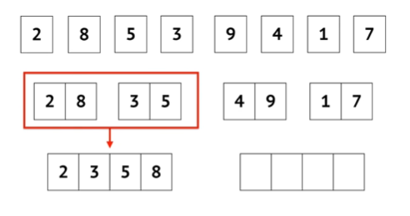
Merge sort

Slide 16
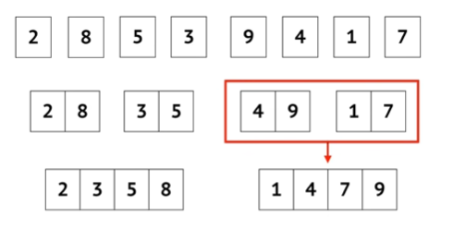
Merge sort

Slide 17
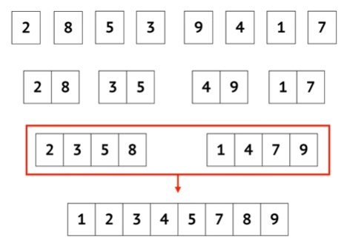
Merge sort

Slide 18
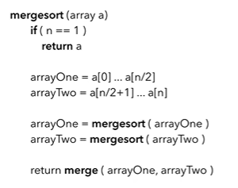
Pseudocode for recursive part logic

Slide 19
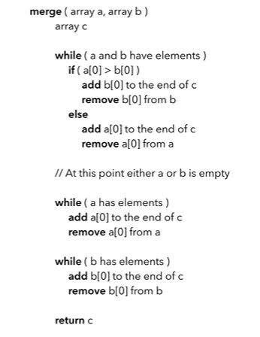
Pseudocode for merge part logic

Slide 20
Quick sort
Quick sort is a divide-and-conquer sorting algorithm. It works by choosing a pivot element and partitioning the array into:
Elements smaller than pivot
Elements greater than pivot
Then it recursively sorts each part.

Slide 21

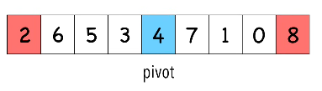
Quick sort
When you choose the pivot try to use the median-of-three, where u look at first mid and last elements of the array. Then sort the 3 elements and use the mid as pivot.

Slide 22
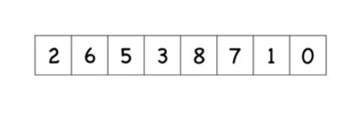
Quick sort

Slide 23
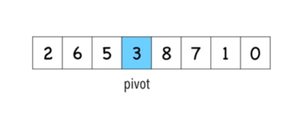
Quick sort

Slide 24
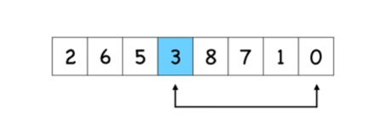
Quick sort

Slide 25
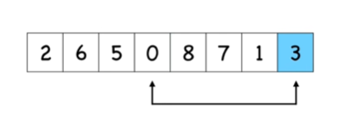
Quick sort

Slide 26
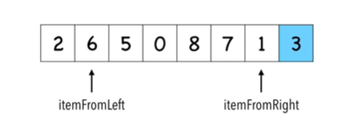
Quick sort
itemFromLeft that is larger than pivot
itemFromRight that is smaller than pivot

Slide 27
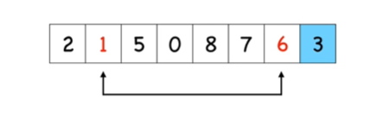
Quick sort
itemFromLeft that is larger than pivot
itemFromRight that is smaller than pivot

Slide 28
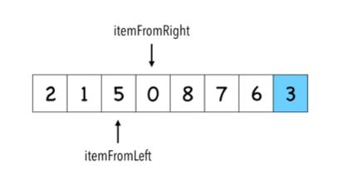
Quick sort

Slide 29
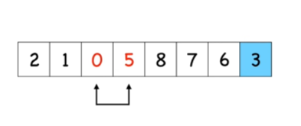
Quick sort

Slide 30
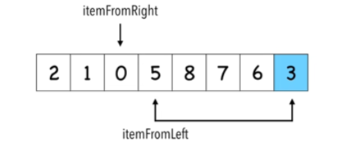
Quick sort

Slide 31
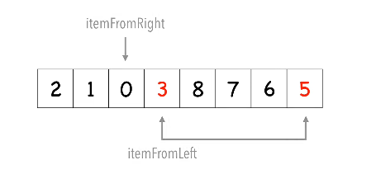
Quick sort

Slide 32
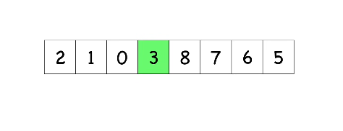
Quick sort
Correct position in final, sorted array
Items to the left are smaller
Items to the right are lager

Slide 33
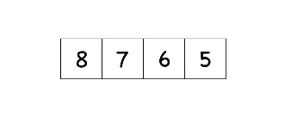
Quick sort

Slide 34
Quick sort

Slide 35
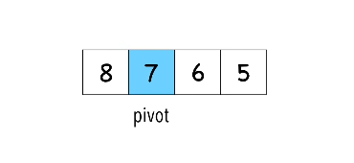
Quick sort

Slide 36
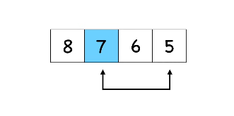
Quick sort

Slide 37
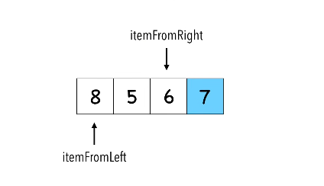
Quick sort
itemFromLeft that is larger than pivot
itemFromRight that is smaller than pivot

Slide 38
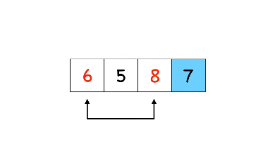
Quick sort

Slide 39
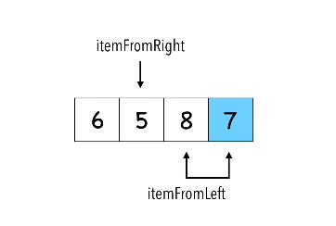
Quick sort

Slide 40
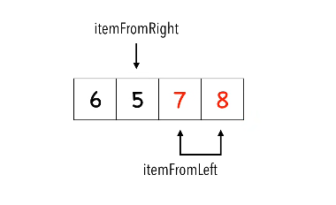
Quick sort

Slide 41
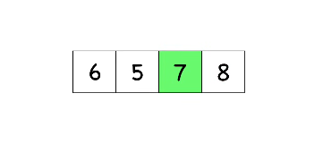
Quick sort

Slide 42
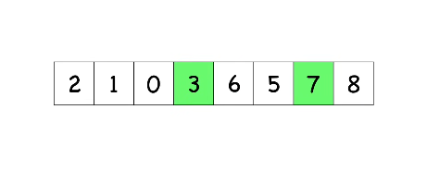
Quick sort

Slide 43
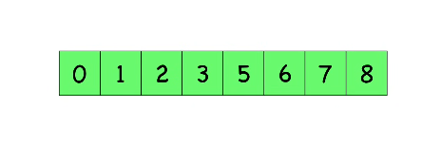
Quick sort

Slide 44
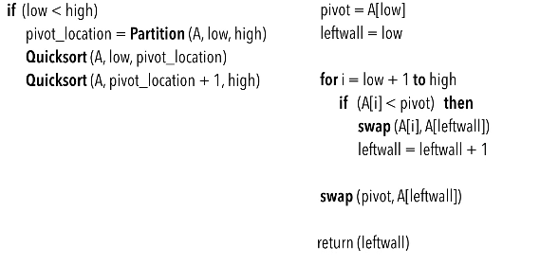
Pseudocode for quicksort logic + partition

